Slide 1
Power BI Level 01
Assessment Design or Wireframe

Slide 2
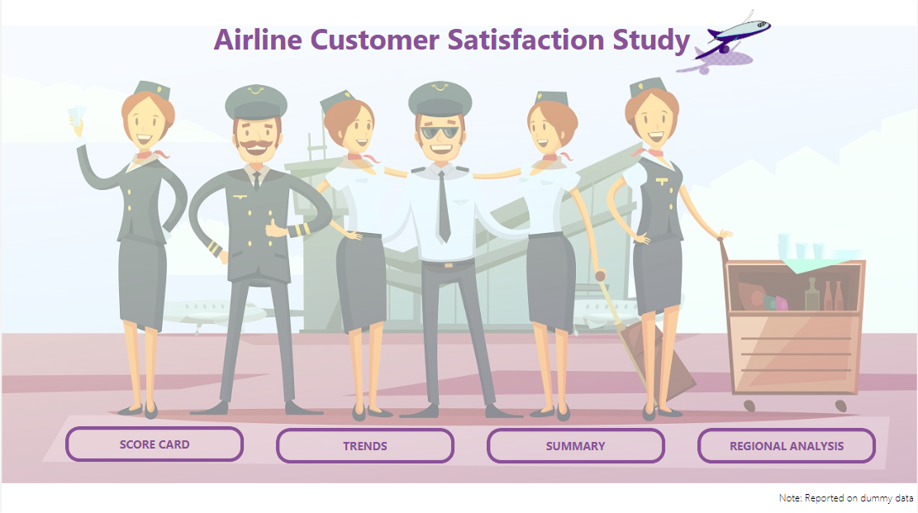
Button to navigate to slide 3
Button to navigate to slide 4
Button to navigate to slide 5
Button to navigate to slide 6

Slide 3
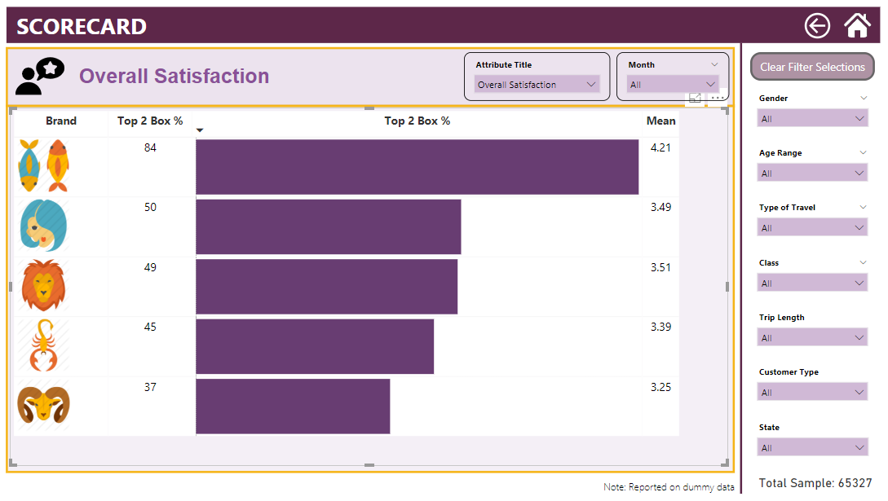
Button to clear below filters
All slicers
on
right hand side of each page should sync on all the pages
If sample goes below 500 then change the font color to red

Slide 4
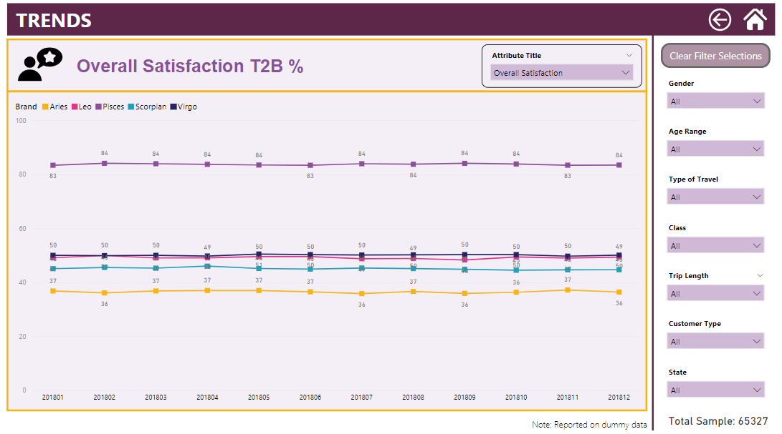
Button to clear below filters
All slicers
on
right hand side of each page should sync on all the pages
If sample goes below 500 then change the font color to red

Slide 5
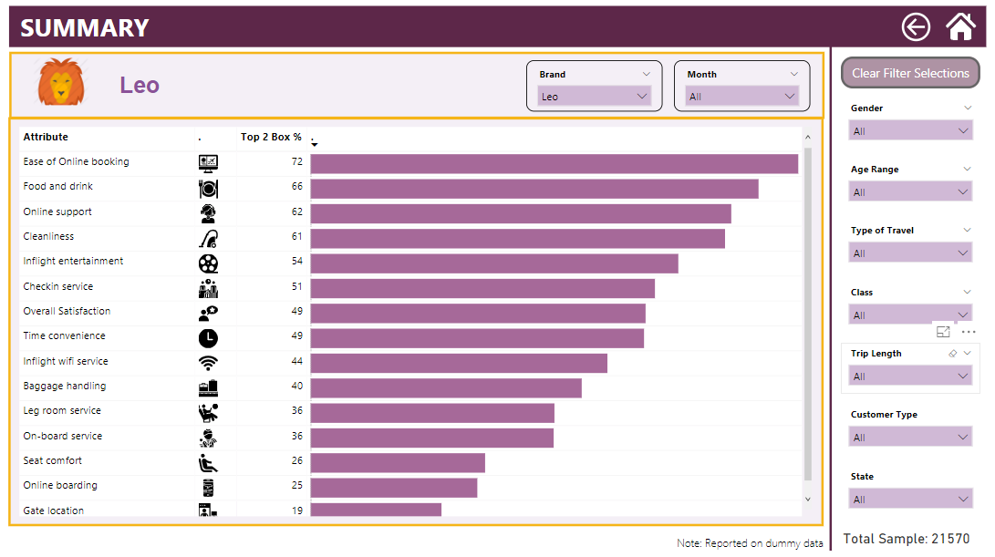
Button to clear below filters
All slicers
on
right hand side of each page should sync on all the pages
If sample goes below 500 then change the font color to red

Slide 6
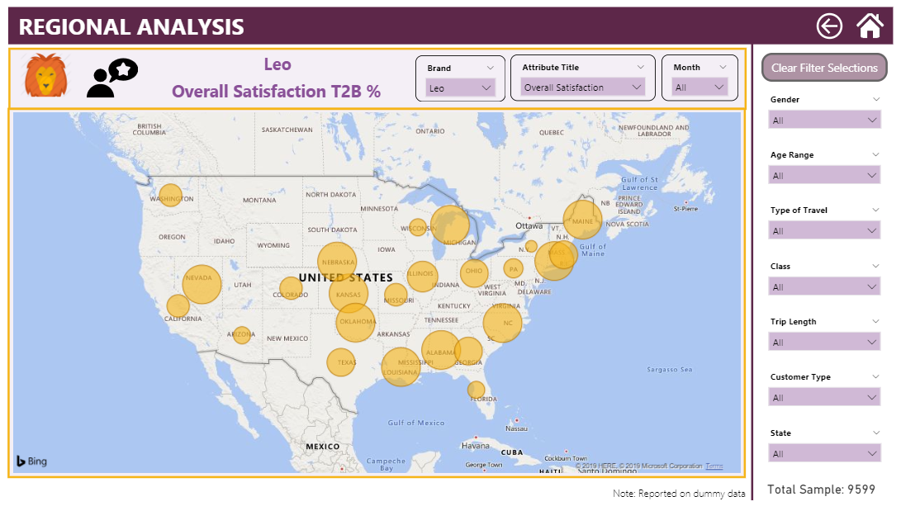
Button to clear below filters
All slicers
on
right hand side of each page should sync on all the pages
If sample goes below 500 then change the font color to red

Slide 7
Color Theme to be used for Report
RGB(245,180,24)
(#F5B418)
RGB(222,54,139)
(#DE368B)
RGB(138,81,152)
(#8A5198)
RGB(32,160,185)
(#20A0B9)
Note1: The entire report should use this color theme.
Note 2: Brand colors should be consistent across all the pages
RGB(40,35,93)
(#28235D)
RGB(93,39,73)
(#5D2749)
RGB(129,187,151)
(#81BB97)
RGB(151,134,121)
(#978679)

